Slide 1
Software-Based Routers
Motivation
Enabling innovation in networking research
Software data planes
Recaps:
  OpenFlow: Enabling Innovation in Campus Networks
  The Click Modular Router
Optional reading
  RouteBricks: Exploiting Parallelism To Scale Software Routers
Notes:
Stronger processing power and advanced software features are making software-based routers a reality. They may not replace core routers, but they'll take over.
Motivation: Network virtualization played an important role throughout the historical evolution of SDN, substantially predating SDN yet taking root as one of the first significant use cases for SDN.
The data plane is a part of a network through which user packets are transmitted. ... In software-defined networking (SDN), the data plane is found in the software. Data plane refers to all the functions and processes that forward packets/frames from one interface to another. Control plane refers to all the functions and processes that determine which path to use. Routing protocols, spanning tree, ldp, etc are examples
OpenFlow as the first standard communications interface defined between the control and forwarding layers of an SDN architecture. OpenFlow allows direct access to and manipulation of the forwarding plane of network devices such as switches and routers, both physical and virtual (hypervisor-based).
Click is a new software architecture for building flexible and configurable routers. A Click router is assembled from packet processing modules.
Route Bricks, some characteristics similar to Software Defined Network, on which the framework is deployed.

Slide 2
Active Networking Recap
Network API exposes capabilities
  Processing, queues, storage
Custom code/functions run on each packet
E.g., conventional IP is best effort, dst based
  When could this be insufficient?
Notes:
APIs are the link between the applications and the SDN controller. The applications can tell the network what they need (data, storage, bandwidth, and so on) and the network can deliver those resources, or communicate what it has. These APIs support a wide variety of applications.

Slide 3
Two models of active networks
“Capsule”
  Packet carries code!
Programmable router
  Operator installs modules on router
Pros/cons?
Notes:
Active networking and software-defined networking
Two major approaches were conceived: programmable network elements ("switches") and capsules, a programmability approach that places computation within packets traveling through the network. Treating packets as programs later became known as "active packets".
Routers are active. Extendable at packet level in the form of Capsules. A code distribution scheme.

Slide 4
Criticisms
Too far removed from conventional networks
  Upgrade/deployability?
Capsule was considered insecure
No killer apps (continues to be problem)
Performance?

Slide 5
Three logical stages (more hindsight)
Active networking era
  Case for “programmable” network devices
“Separation” of control vs data era
  Specifically about routing etc
OpenFlow/Network OS era

Slide 6


Network Management
Traffic Engineering Performance
Security
Compliance
Resilience
Notes:
Networks start off providing a basic functionality – send packets from point A to point B. But that’s not the end of the story .. Administrators want to achieve other things with the network – performance

Slide 7
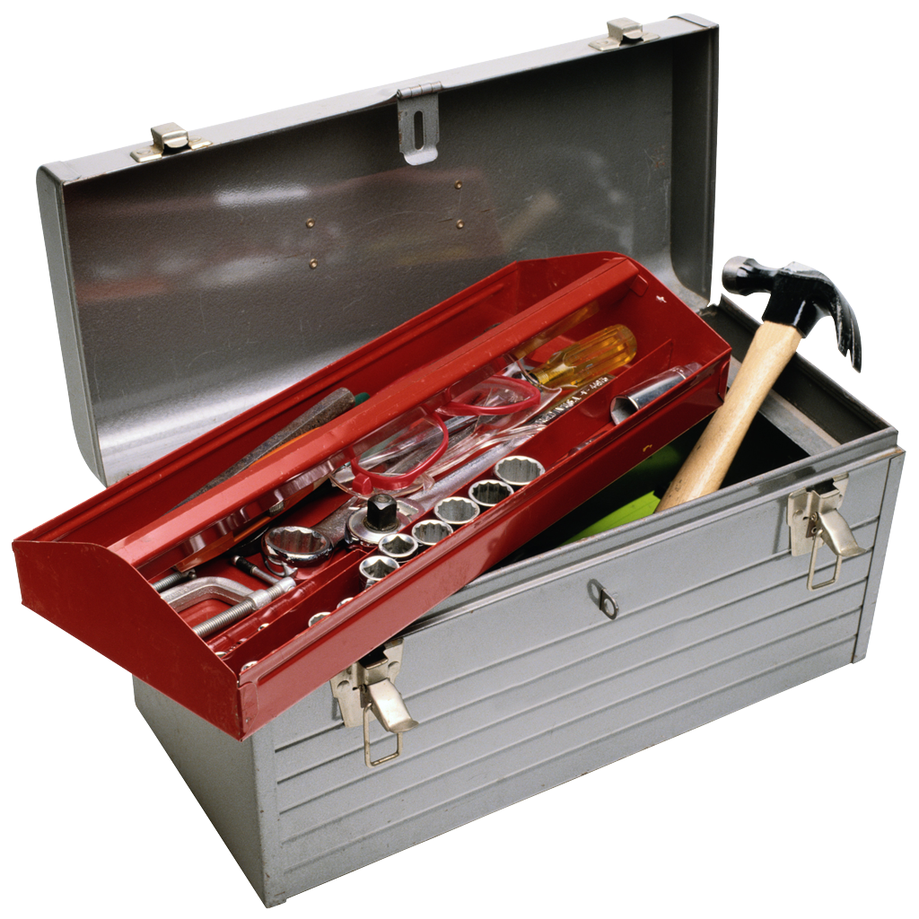
Problem: Toolbox is bad!
Traffic Engineering Performance
Security
Compliance
Resilience
Notes:
Toolbox today

Slide 8
Why: Toolbox is implicit in routers!
Traffic Engineering Performance
Security
Compliance
Resilience
Motivation: Management is complex, expensive, fragile
Need: Direct control, expressive policy, network-wide views
Notes:
Makes the network really brittle, makes it hard to reason whether your policy goals are being met. Toolbox relies on some complex distributed routing algorithms to converge, not clear what happens under failures etc

Slide 9
Building routers
Fast
Programmable
  custom statistics
  filtering
  packet transformation
  …
RouteBricks slides: Katerina Argyraki, 2009

Slide 10
Why programmable routers
New ISP services
  intrusion detection, application acceleration
Simpler network monitoring
  measure link latency, track down traffic
New protocols
  IP traceback, Trajectory Sampling, …
Enable flexible, extensible networks

Slide 11
Today: fast or programmable
Fast “hardware” routers
  throughput : Tbps
  little programmability
Programmable “software” routers
  processing by general-purpose CPUs
  throughput < 10Gbps
Notes:
Best of both worlds

